Slide 1


Study in Beijing PM2.5 Data Set

Slide 2

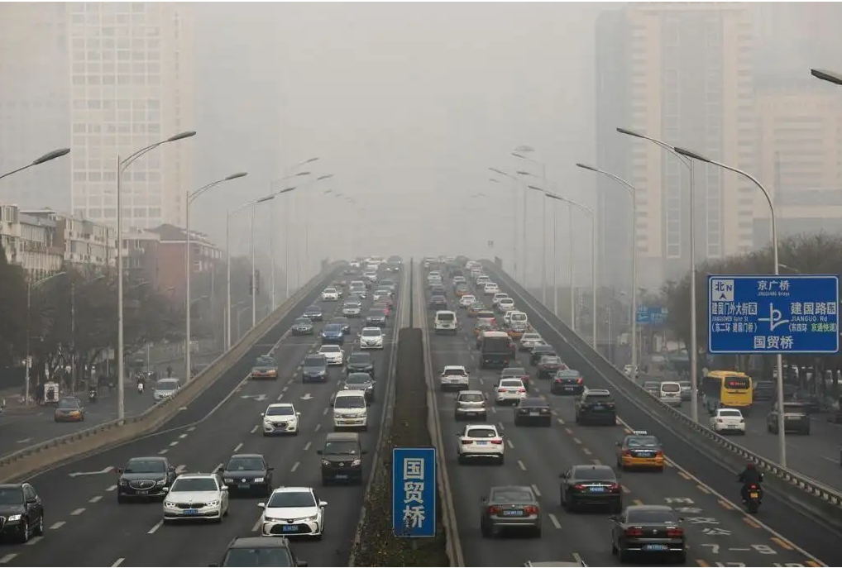

Slide 3
Content
1
Gather Data
2
Visualizing Data Analysis
3
Exploratory Data Analysis
4
Results and Analysis
5
Discussion

Slide 4

1
Gather Data
The dataset is from UCI ML data repository(https://archive.ics.uci.edu/ml/datasets/Beijing+PM2.5+Data).
This hourly data set contains the PM2.5 data of US Embassy in Beijing.

Slide 5
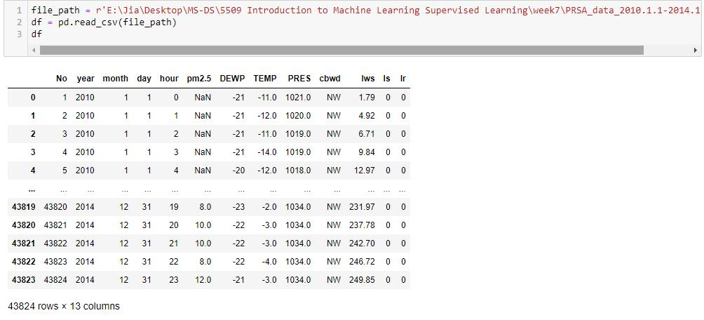
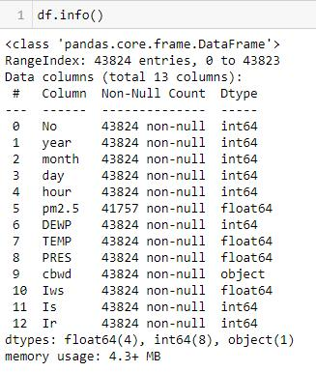
1.1 Import data

Slide 6
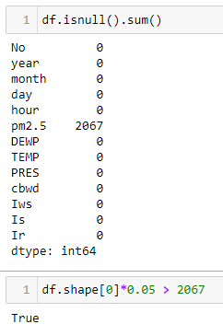
1.2 Inspect null values
Complete case analysis is to drop any observations (rows) that have null values. It is suitable if the number of observations with null values are very small (say, less than 5%) compared to the total number of observations.

Slide 7
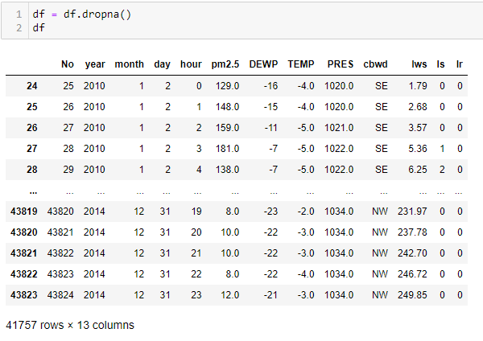
1.3 Deal with missing data
After cleaning missing data, the dataset convert to 41757 rows and 13 columns.

Slide 8

2
Visualizing Data Analysis

Slide 9
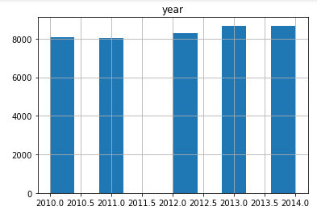
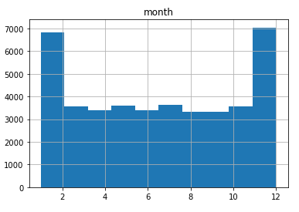
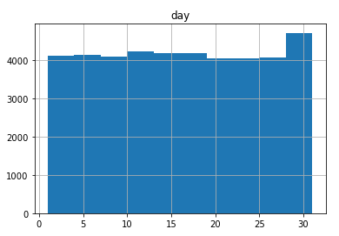
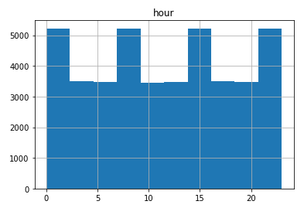
2.1 Plot the distribution of each feature

Slide 10
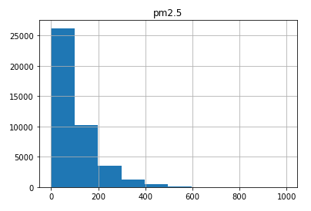
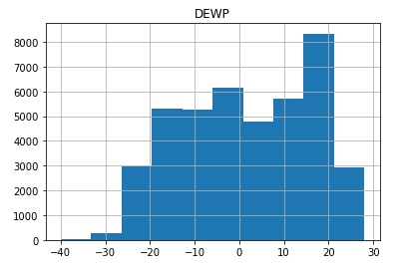
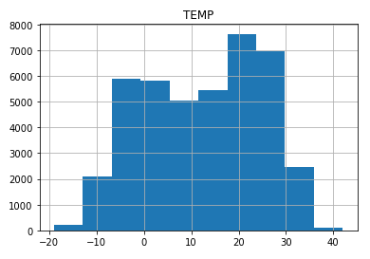
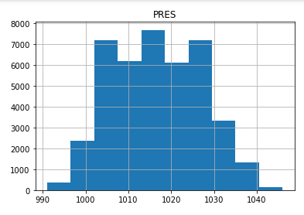
2.1 Plot the distribution of each feature

Slide 11
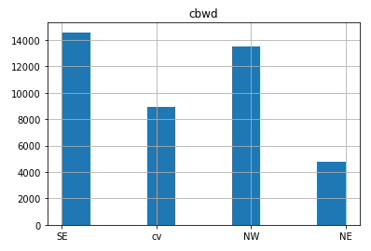
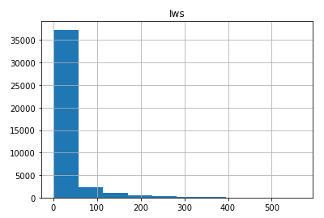
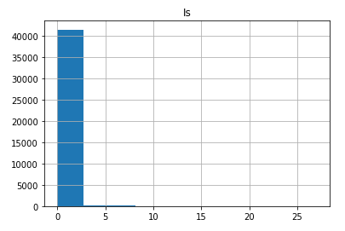
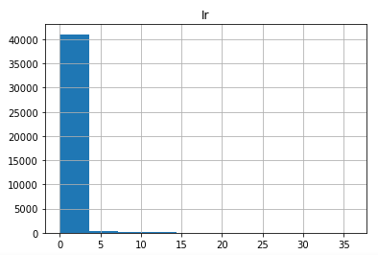
2.1 Plot the distribution of each feature

Slide 12
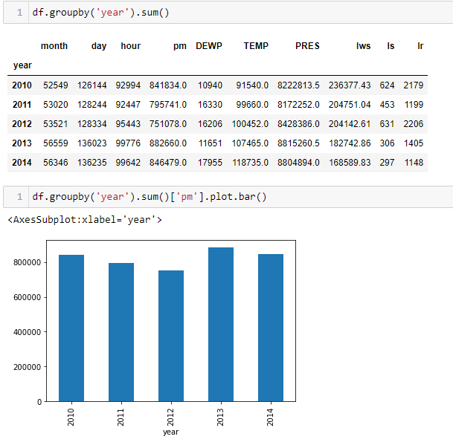
2.2 PM2.5 in yearly changes
I studied the pm2.5 in yearly changes. In 2013, the total observed pm2.5 is the highest, and is the lowest in 2012.

Slide 13
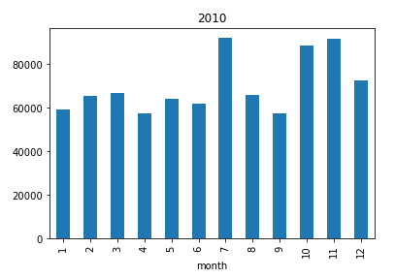
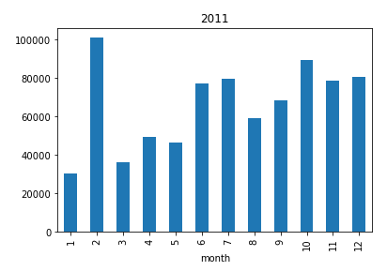
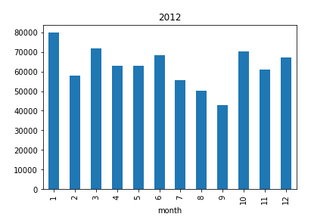
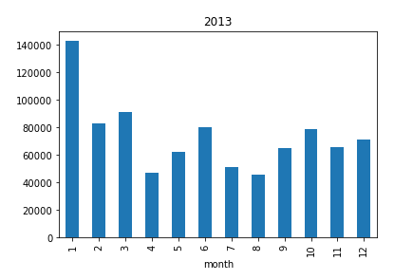
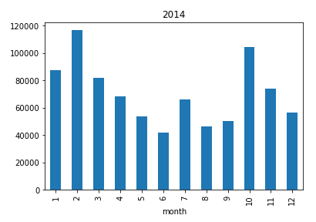
2.3 PM2.5 in monthly changes from 2010 to 2014

Slide 14

3
Exploratory Data Analysis

Slide 15
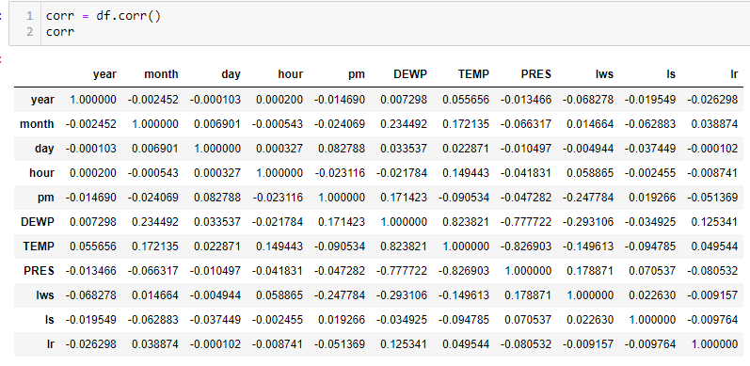
3.1 Get correlation matrix

Slide 16
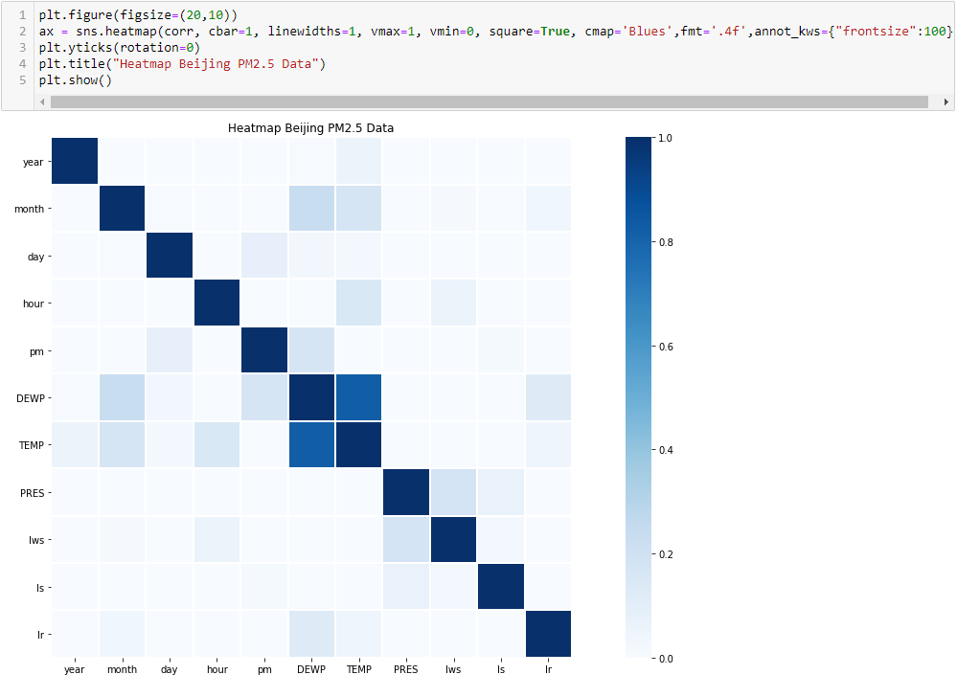
3.2 Display a heat map

Slide 17

3.3 Best predictors based on adjusted R squared in linear regression
3.3.1 Data preparation
Use sklearn.model_selection.train_test_split function to split the data frame to X_train, X_test, y_train, y_test. X_train is 80% of observation randomly chosen. X_test is the rest 20%

Slide 18
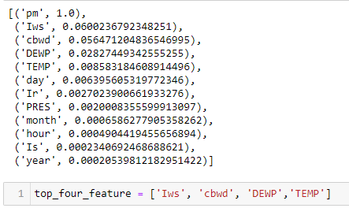
3.3.2 Linear regression
Linear regression uses adjusted R squared as fit performance. According to the adjusted R squared values, I get the top four relative features, which is Iws, cbwd, DEWP, TEMP.

Slide 19
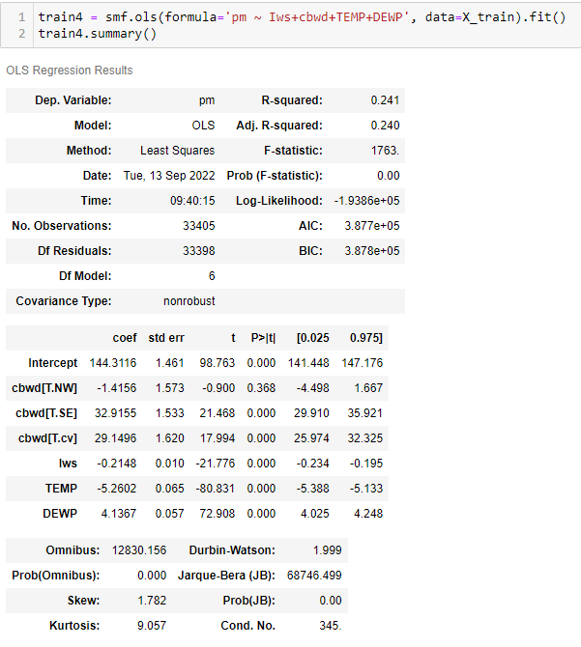
3.4 Forward stepwise refinement
l use the forward stepwise selection method to create more accurate predictors for pm2.5. Conduct the algorithm for feature = 1, my best solution is Iws. Conduct the algorithm for features up to 4 , my best solution is Iws+cbwd+TEMP+DEWP. The result is the same as the previous study which is based on adjusted R squared.

Slide 20
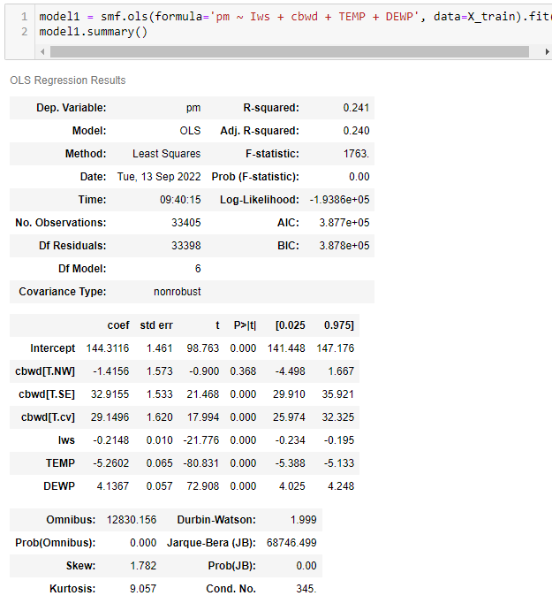
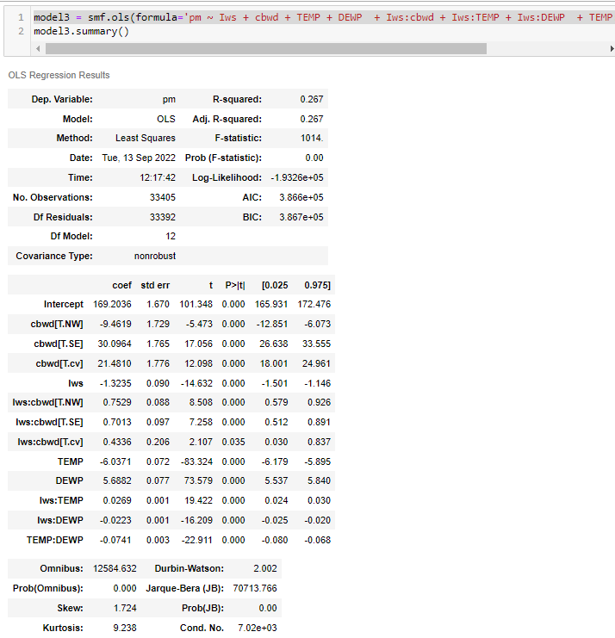
3.5 Multi-linear
Construct a multi-linear model without interaction terms
2. Construct a multi-linear model with interaction terms

Slide 21
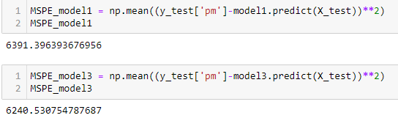
3.6 Prediction function
I calculate the mean squared prediction error to compare to which model is better. the MSPE of model3 is smaller than model1, it indicates the model 3 is better than model1.

Slide 22

4
Results and Analysis

Slide 23
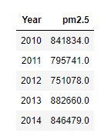
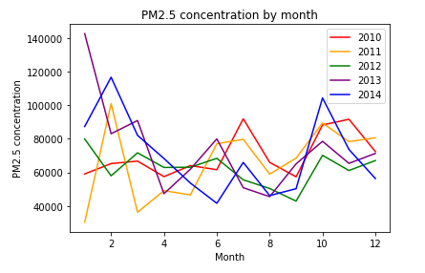
1. PM2.5 in yearly changes
2. PM2.5 in monthly changes
?

Slide 24
3. Three different methods to analyze the best predictors
The correlation coefficient matrix and heatmap
Get best predictors based on adjusted R squared in simple linear regression
Forward stepwise selection method
4. Construct two multi-linear regression models without interaction and with interaction.
5. Calculate the mean squared prediction error for each model
?

Slide 25
5
Discussion

Slide 26
To Do
Analyze more relatively data
Build relatively model

Slide 27
THANKS

